Slide 1
Team PowerPuffs
Ishita P, Ben M, Catherine C, Ryan Z

Slide 2
NASA Project
Exploring data describing environmental elements across the world
Discovering the relationship between these locations and if the could host a renewable energy plant
Defining new places and opportunities for renewable energy sources

Slide 3
Our Goals
Educational website that help users explore data
Filtering & Searching
Map Feature (?)
Accounts to save and download results
PDF, Excel

Slide 4
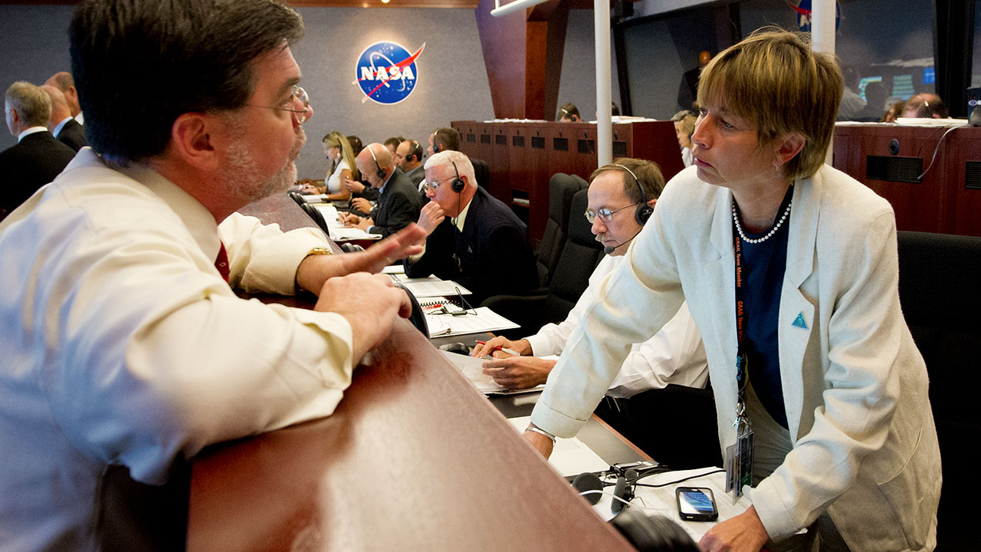

Stakeholders
Scientists
Researchers
Students
General Public
Web Developers
Audience & Prof/TA

Slide 5
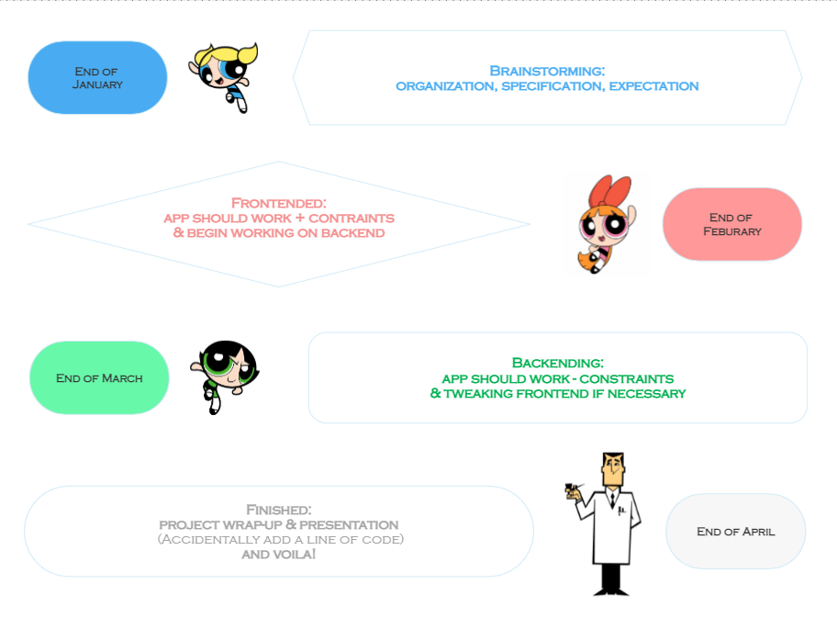

Slide 6









Slide 7
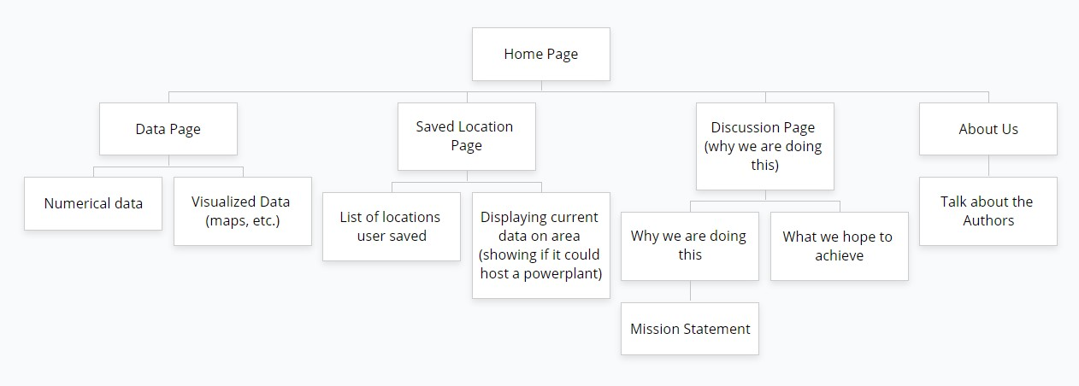

Slide 8
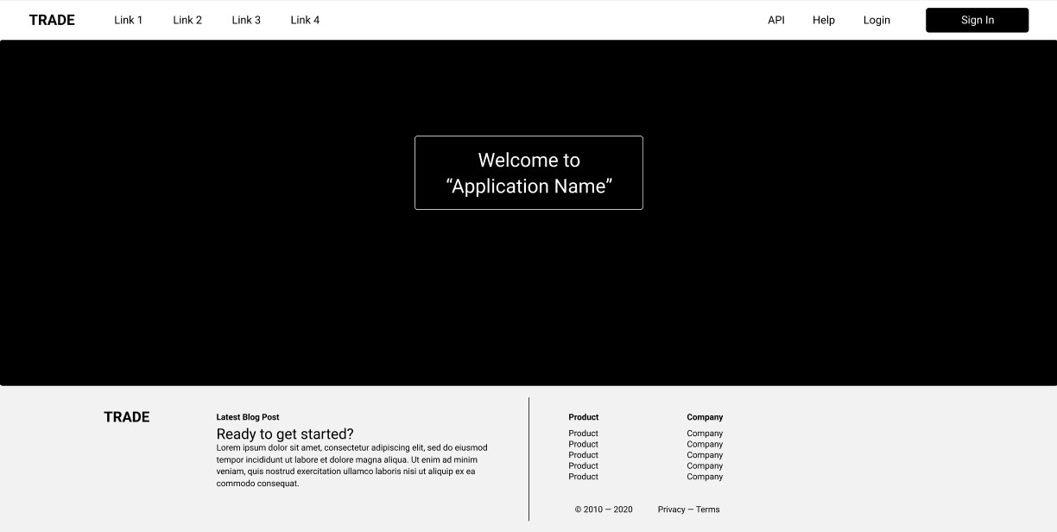

Slide 9
Thank You!
Questions?

Slide 10
Citations
https://www.science.org/do/10.1126/science.aal1141/abs/cc_nasadiversity_16x9.jpg
https://www.google.com/url?sa=i&url=https%3A%2F%2Fwww.science.org%2Fcontent%2Farticle%2Fwomen-make-just-15-nasa-s-planetary-mission-science-teams-here-s-how-agency-trying&psig=AOvVaw1ymf7qq1eBGYmU6GY8uQyT&ust=1674930347583000&source=images&cd=vfe&ved=0CA8QjRxqFwoTCIDKnvWv6PwCFQAAAAAdAAAAABAE

